Slide 1
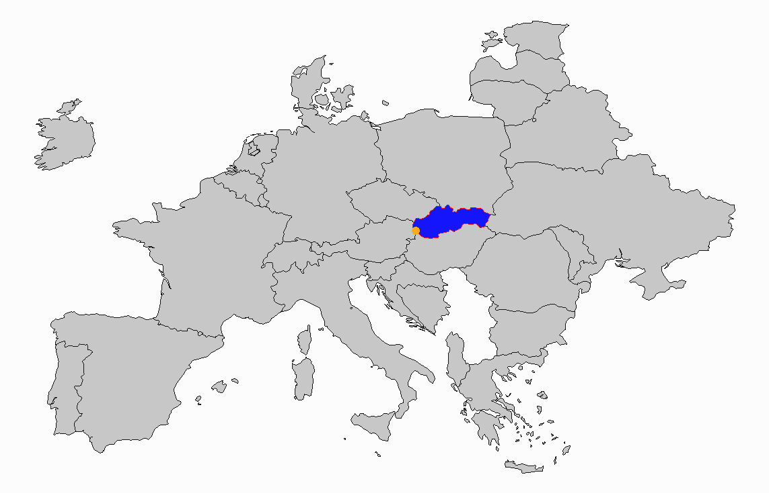
Young People of Slovakia
Michael Mahoney, Tyler Price, Nathan Shepherd

Slide 2
Background & Motivation
Survey conducted by Comenius University in Bratislava, 2013
1010 participants, 150 features
Demographic, Continuous, Categorical
Music, Movies, Hobbies, Phobias, Health, Opinions, Spending
Can we use participant responses to accurately predict others?
How well can a DNN classifier predict compared to Regression?
Notes:
Very rich dataset. Due to time we were only able to look at a portion of the data

Slide 3
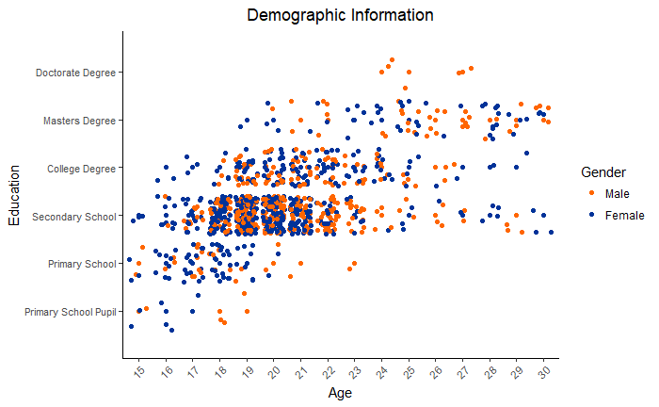
Data Exploration

Slide 4
Data Preprocessing
Categorical columns converted to Numeric
No duplicate observations
Missing Completely at Random ~1%
Median Imputation
Targets were transformed into 3 level factors for some models
X columns normalized prior to entering models
70% / 30% training/test split

Slide 5
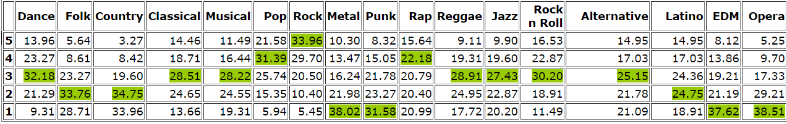
Music Preferences
17 Genres of Music
Don’t Enjoy At All.. 1 - 2 - 3 - 4 - 5 ..Enjoy Very Much
Slovakians hate Metal, Punk, EDM, and Opera

Slide 6
DNN Classifier - Music
3 Fully Connected Layers - 256, 128, 56 nodes per layer
Proximal Adagrad Optimizer
Relu Activation Function
.01 Learning Rate, 250/1500 epochs
.1 Dropout rate to reduce potential overfitting
Notes:
Normalized X-values

Slide 7
Neural Network vs Ordinal
Used only other music preferences to make predictions
F1-score is the weighted average of precision and recall
Backwards elimination to reduce variables in Ordinal models
DNN Classifier outperformed Ordinal in 6 comparative models
Notes:
Normalized X-values
Due to time, each individual network wasn’t able to be optimized in terms of learning rate, activation function, epochs, etc. General specs were tested, then implemented across the board

Slide 8
Key Findings
(Graph Analysis)
Slovaks are a pretty neg bunch
Class Imbalance needs to be addressed
Many genre’s responses were polarized
A Story in Reggae’s Coefficients
 | Estimate | Std. Error | z value | Pr(>|z|)
Punk | 0.55347 | 0.06524 | 8.483 | < 2e-16 ***
Hip-Hop/Rap | 0.42086 | 0.05961 | 7.06 | 1.67e-12 ***
Swing/Jazz | 0.41647 | 0.06646 | 6.266 | 3.69e-10 ***
Latin | 0.16484 | 0.06234 | 2.644 | 0.00819 **
Notes:
Normalized X-values

Slide 9
The History of Reggae
American Punk
1950-1960
Jamaican Ska & Rocksteady
American Ska
Caribbean Music
Punk Rock Steady
American Jazz
Jamaican R&B
Reggae
1960’s
Rastafari movement to USA through New Orleans
Reggaeton
American R&B
Latin American Hip Hop
American Hip Hop
Notes:
Positive Coefficient & Significant indicator in Hiphop, Latin, Punk, Jazz

Slide 10
Phobias
10 listed phobias
Flying
Storms
Darkness
Heights
Spiders
Snakes
Rats
Aging
Dangerous Dogs
Public Speaking

Slide 11
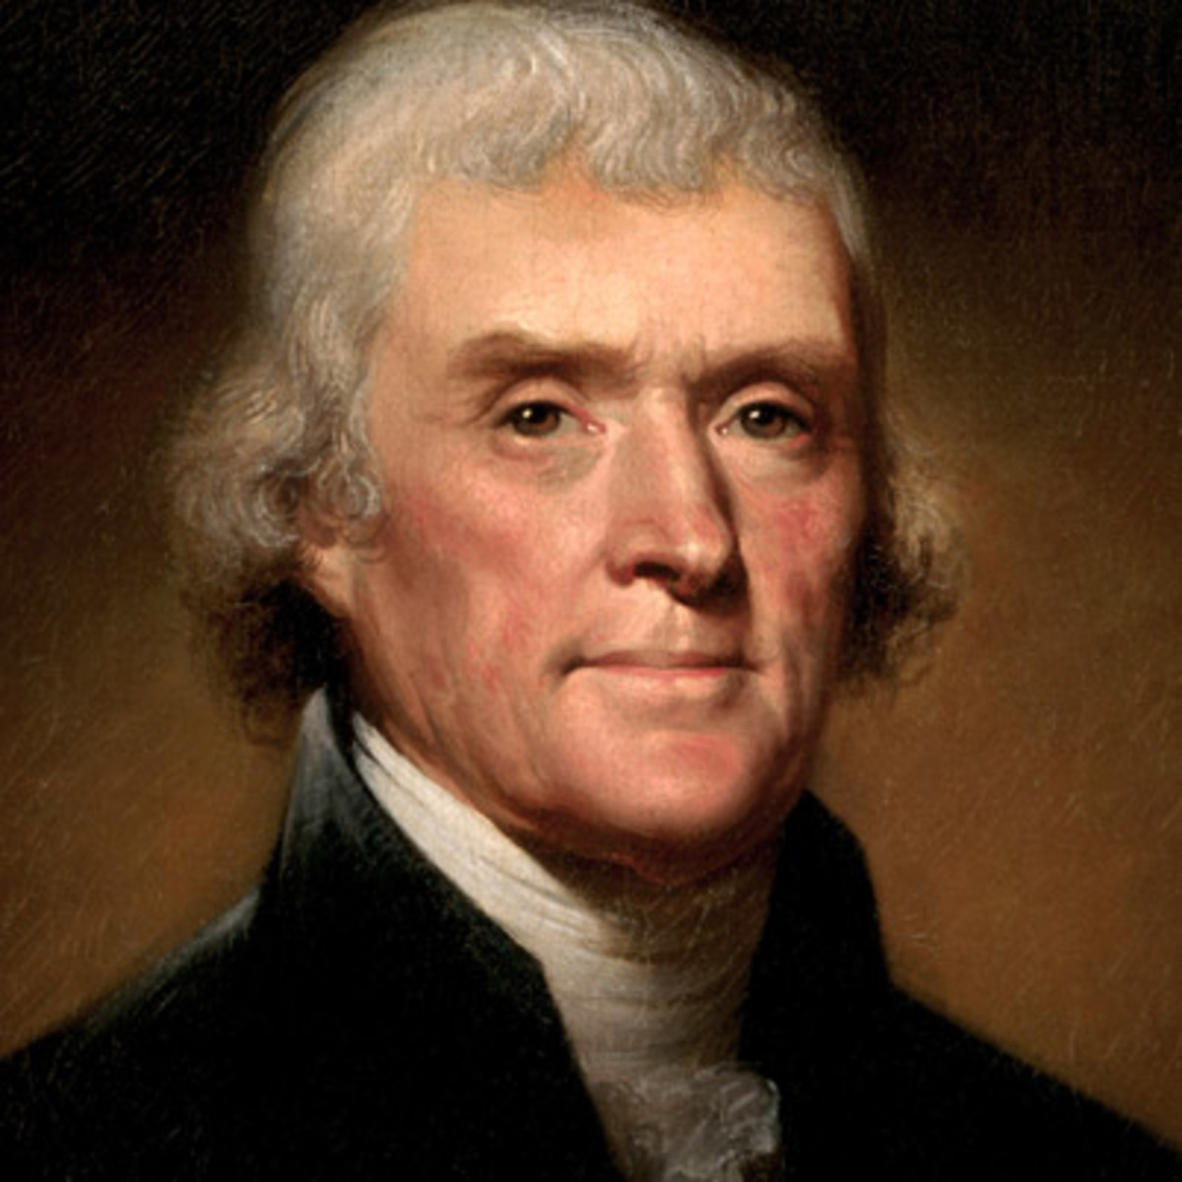
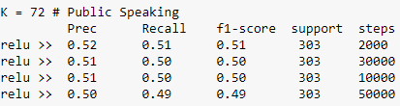
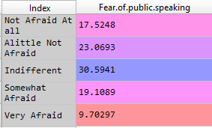
Glossophobia
Fear of public speaking
Thomas Jefferson

Slide 12

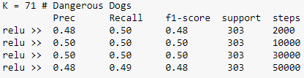
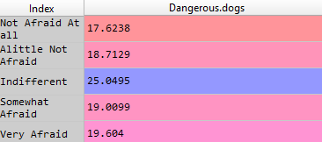
Cynophobia
Fear of dogs
A Dangerous Dog

Slide 13

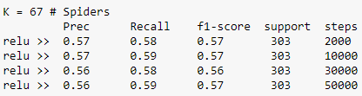
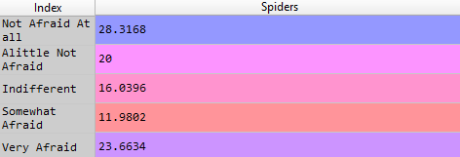
Arachnophobia
Fear of Spiders
A Giant Spider

Slide 14

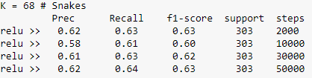
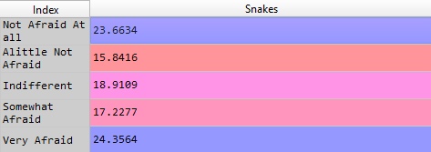
Ophidiophobia
Fear of Snakes
Lord Voldemort

Slide 15
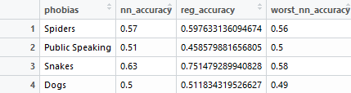
How did we do, Phobia wise?
We can predict Thomas Jefferson but not Lord Voldemort

Slide 16
Future Steps
Expanding data source/more participants
Develop individually optimized models
Explore other sections of the dataset/cross-predictions
Develop reusable DNN Classifier Interface
Upload dataset, specify target, DNN trains, tests, evaluates, reports
Notes:
Normalized X-values

Slide 17
Questions?
Notes:
Normalized X-values

